Slide 1
Forms

Slide 2

Introduction
Preventing Form Submission
Accessing Form Fields Showing Validation Errors Posting From JavaScript

Slide 3
Preventing Form Submission

Slide 4


submit

Slide 5


submit event
validation format form data

Slide 6
The submit Event
let form = document.getElementById('user-form');
form.addEventListener('submit', event => {
// prevent the browser from submitting the form event.preventDefault();
});

Slide 7
Accessing Form Fields

Slide 8
form.elements[]
let form = document.getElementById('user-form');
form.addEventListener('submit', event => { let user = form.elements['user'];
let avatarFile = form.elements['avatar-file'];
console.log(user.value, avatarFile.value); event.preventDefault();
});

Slide 9
Showing Validation Errors

Slide 10
Form Field
<input name="user" placeholder="User Name"/>
<span id="user-error"></span>

Slide 11
Form Field
let user = form.elements['user'];
let userError = document.getElementById('user-error');
userError.textContent = 'Invalid entry'; userError.style.color = 'red'; user.style.borderColor = 'red'; user.focus();

Slide 12
Posting From JavaScript

Slide 13
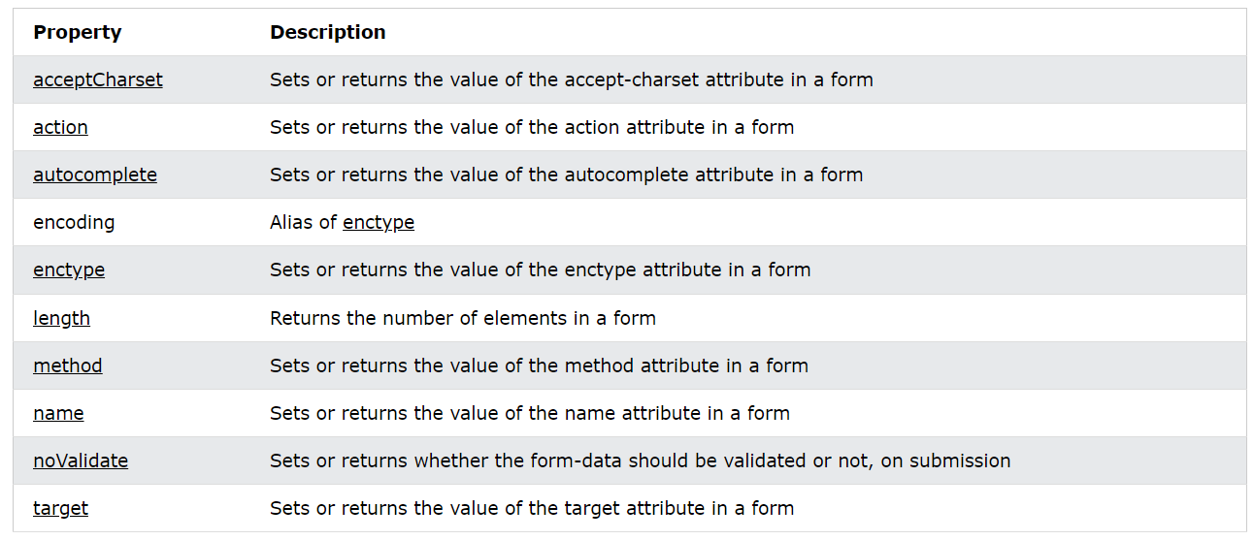
Form Object Properties

Slide 14
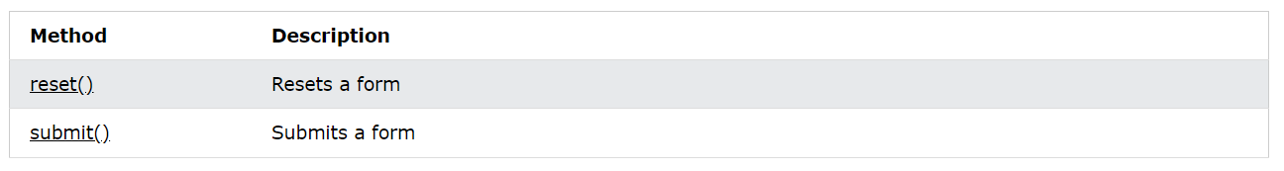
Form Object Methods

Slide 15
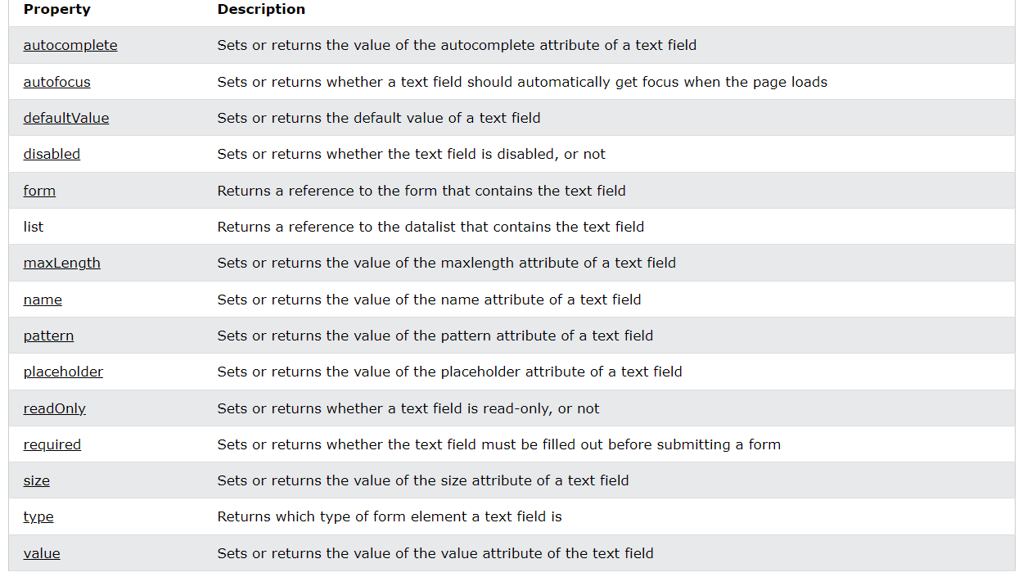
Input Text Object Properties

Slide 16
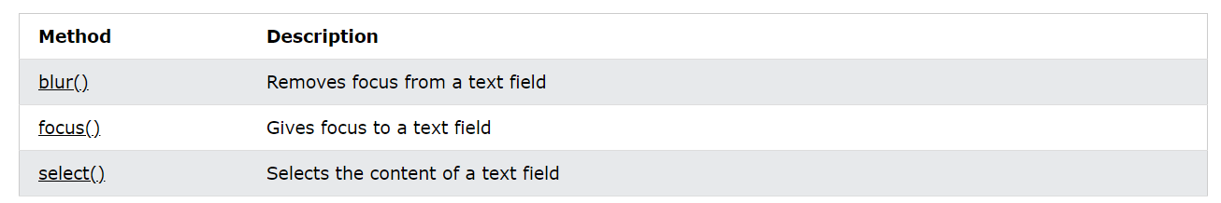
Input Text Object Methods

Slide 17
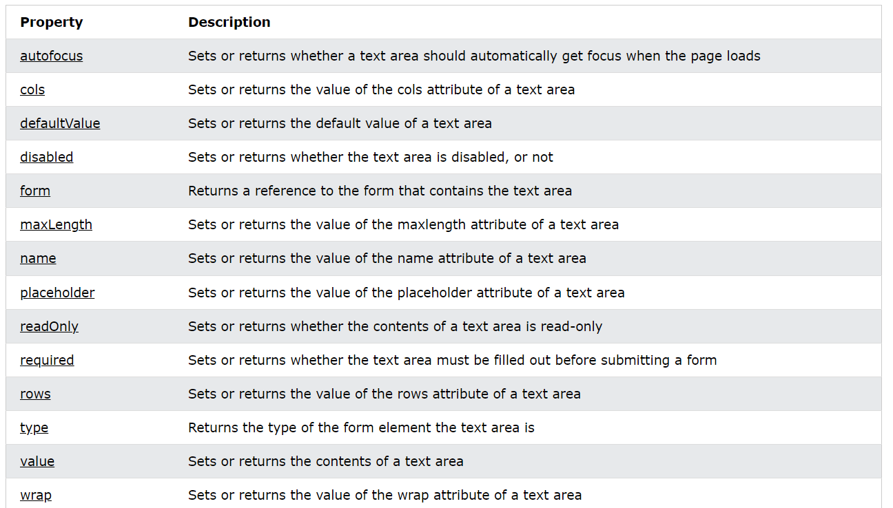
Textarea Object Properties

Slide 18
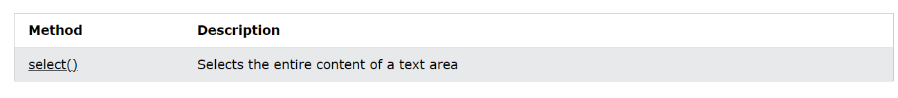
Textarea Object Methods

Slide 19
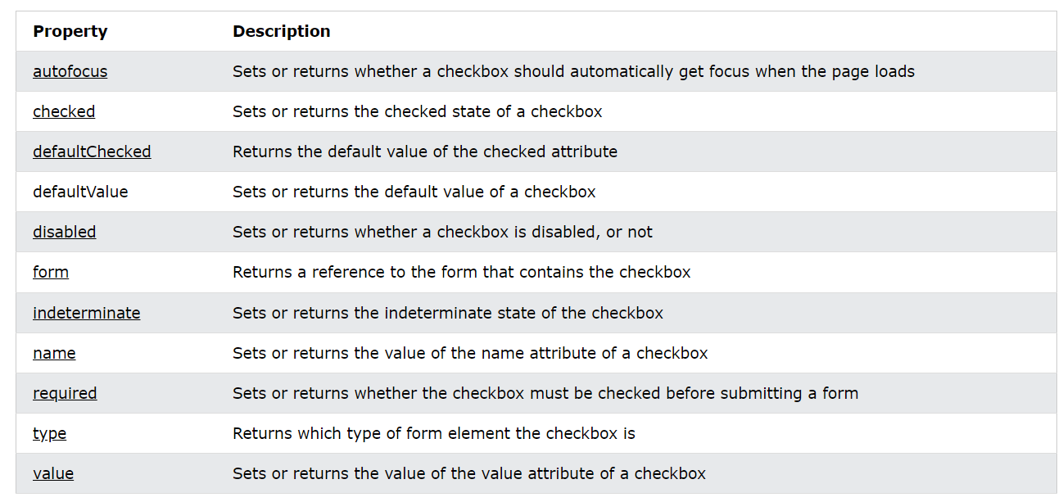
Input Checkbox Object Properties

Slide 20
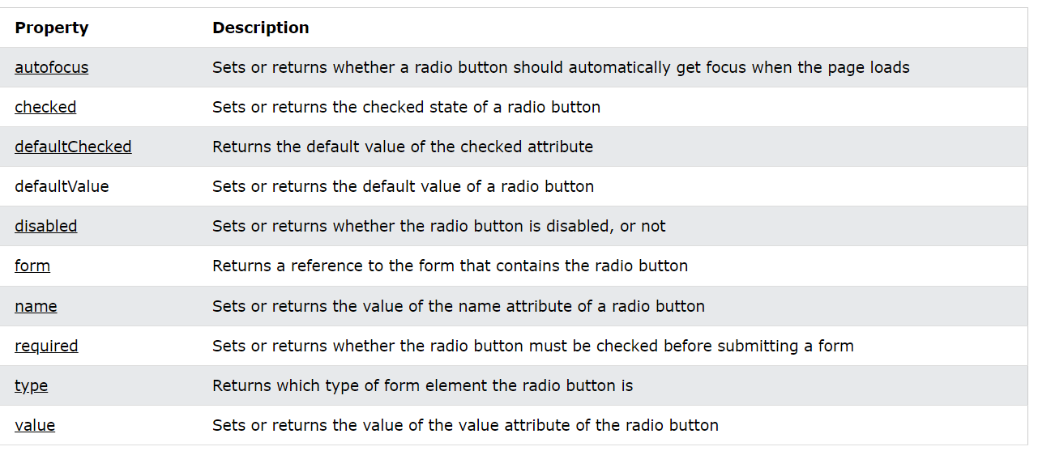
Input Radio Object Properties

Slide 21
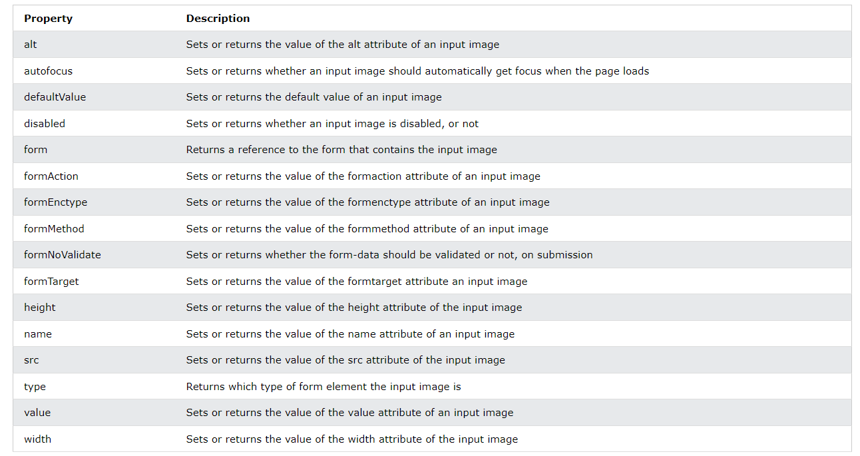
Input Image Object Properties

Slide 22
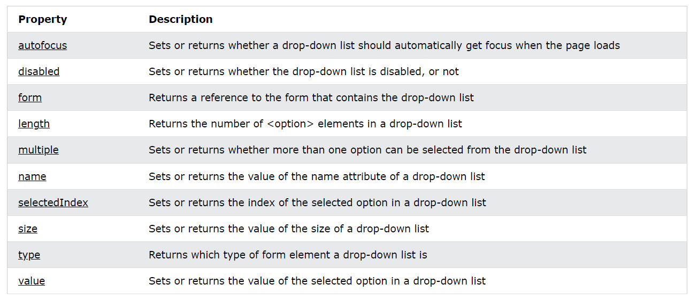
Select Object Properties

Slide 23
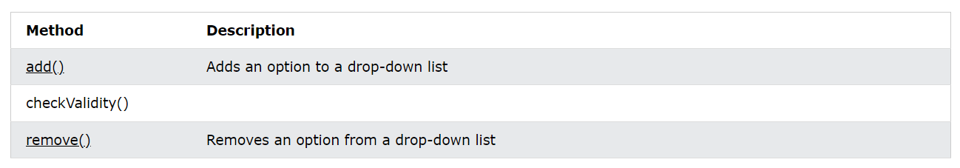
Select Object Methods

Slide 24
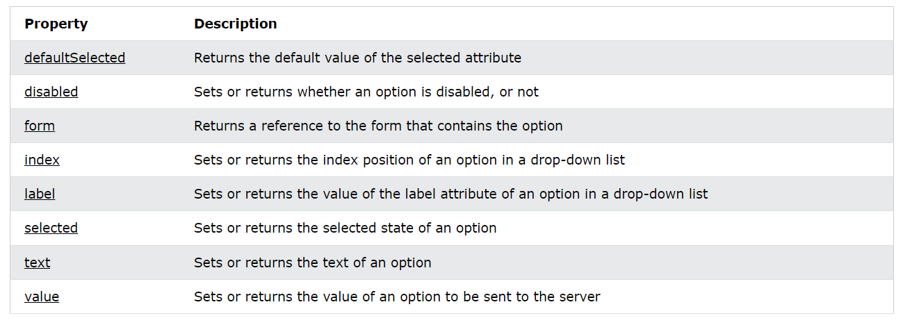
Option Object Properties

Slide 25
Preventing Form Submission
handle submit event
event.preventDefault()
Accessing Form Fields
form.elements['name']
Showing Validation Errors
use CSS styling
element.focus();
Posting From JavaScript
post using jQuery, etc.
call event.preventDefault()
Summary

